Slide 1
Module 1:
GENERAL INQUIRIES
NC State Bureau of Investigation
Criminal Information & Identification Section
Revised May 29, 2026

Slide 2


LAI’s NAME
Phone Number
Email

Slide 3
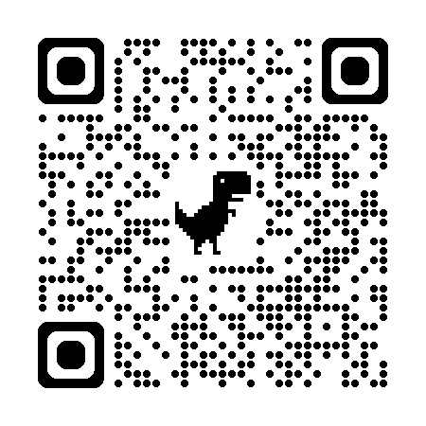
https://www.ncsbi.gov/omnixxlinks
Notes:
Omnixx Links QR code

Slide 4
Objectives
Discuss
  different computer systems that can be accessed by using any device with DCIN connectivity.
Perform
  inquiries on persons and property, using the necessary available information.
Identify & Understand
  the types of responses received as a result of inquiries made.
Describe
  the proper procedures to follow when a hit is received.
Perform
  inquiries into DMV files in NC and other states.

Slide 5

Computer Systems: North Carolina
Division of Criminal Information Network – DCIN
Statewide computer network for exchange of law enforcement and criminal justice info
Maintained by Criminal Information & Identification Section (CIIS) of the NC State Bureau of Investigation (SBI)

Slide 6


Computer Systems: North Carolina
SBI Files
NC Government Files
NC Concealed Handgun Permits
DMV
Wildlife Resource Commission
NC Sex Offender Registration
DAC

Slide 7

Computer Systems: National
National Crime Information Center – NCIC
National computer network for exchange of law enforcement and criminal justice info
Division with the Federal Bureau of Investigation (FBI)
Notes:
ORI is agency specific and acts as an identifier.

Slide 8

Computer Systems: National
FBI Files
Wanted Persons
Missing Persons
Violent Persons
NICS Denied Transaction
Protection Order
Sexual Offender
Unidentified
Foreign Fugutive
Stolen & Felony
Vehicle
License Plate
Article
Protective Interest
Immigration Violator
Gang
Threat Screening Center
Boat
Gun
Securities
Supervised Release
Extreme Risk Protection Order
Identity Theft
Vehicle & Boat Part
ORI File
Image File
Notes:
NCIC houses and searches all these files.

Slide 9

Computer Systems: Other States & Canada
HL
International Justice & Public Safety Information Sharing Network - NLETS
Info including but not limited to:
  Person and Property Files
  Driver Files
  National Insurance Crime Bureau
  Hazardous Materials

Slide 10



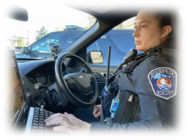

National Files
SBI Files
DCIN
Other states/canada
NC Files
Notes:
Diagram not in manual but is a helpful visual of DCI and how it connects to state and national systems.
DCI acts as a filter to the appropriate system.

Slide 11

INQUIRY
Transaction used to initiate a search of a file(s) using identifiers provided
Some queries cause multiple file search
Spin-Off
Special Options
  Expanded Name Search (ENS)……must add Y
  Related Search Hit (RSH)…………..defaults to Y
  Image Indicator (IND)……………….defaults to Y
Notes:
Purpose – Obtain as much info as possible
Using more than one identifier increases chance of hit
Multiple inquiries by different identifiers may be needed

Slide 12
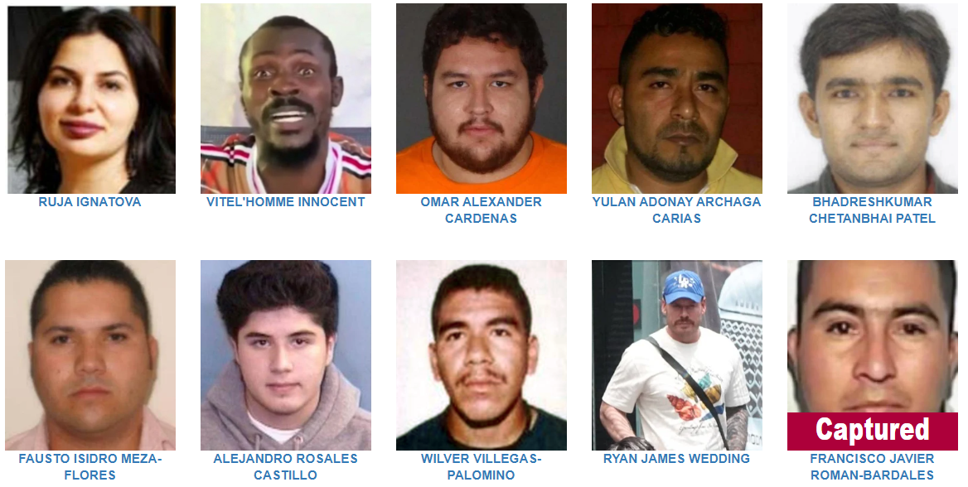
WANTED PERSON INQUIRY
  Adult
  Juvenile
  Felony
  Misdemeanor
  Criminal
  Civil
FBI’s 10 Most Wanted as of 5/28/2025

Slide 13
Wanted Person
QUERY OPTIONS
Name and Number Other Than DOB
Name and DOB
NIC Number
Name NOT searched
Soundex on last name with any first name
Returns specific record
Match based on NUMBER only
Exact DOB
Leave all other fields blank

Slide 14
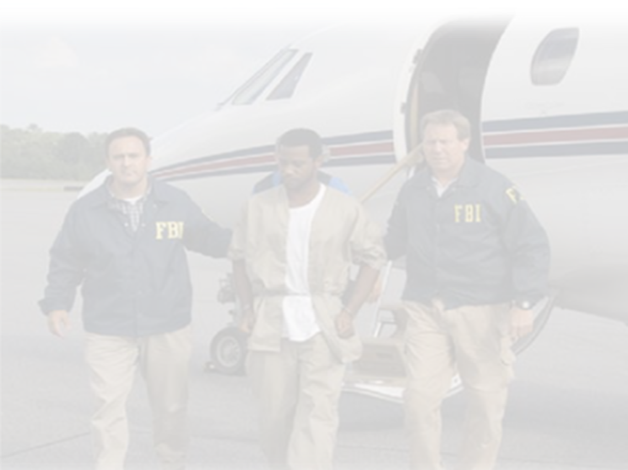

WANTED PERSON
EXTRADITION
Extradition limitations appear at top of record
  Explained in MIS field
NOT in extradition area?
ARE in extradition area?
Another NC
agency?
Extradition expected
- No hit confirmation
- Send AM
Send hit confirmation and locate
Notes:
If Hit Confirmation sending-agency IS included on the extradition limitations and the holder of the record states they will not extradite, confirming agency still needs to send a Locate.

Slide 15

Wanted Person
RESPONSES
NC DAC File
Wanted & Missing Persons Files
Violent Person File
NICS Denied File
Foreign Fugitive File
Protective Interest File
Immigration Violator File
Gang File
Threat Screening Center File
NC CHP File
Protection Order File
Sex Offender File
Supervised Release File
Identity Theft File
NC SOR File
Notes:
NCIC/DCIN files cross-searched.
Yellow file, user will always receive 5 responses, regardless of a record or not.

Slide 16
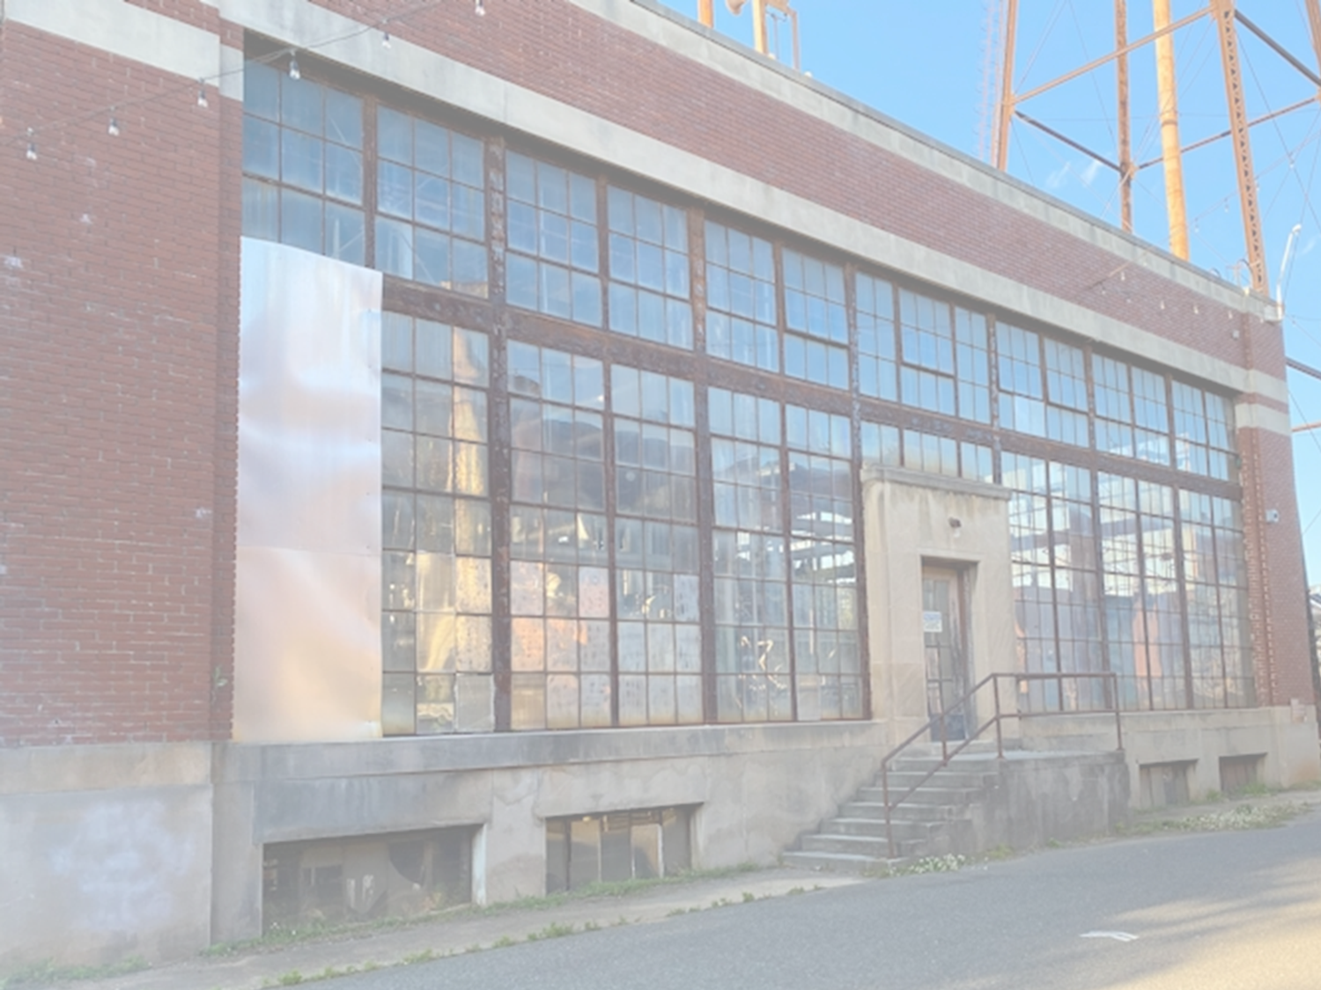
Wanted Person
SCENARIO
While on patrol, an officer notices a suspicious female wandering around some abandoned buildings in a known drug area.
Suspect’s name and DOB is queried to see if she is wanted.
Name: BOBBI JO SMITH
DOB: 03/13/1989

Slide 17
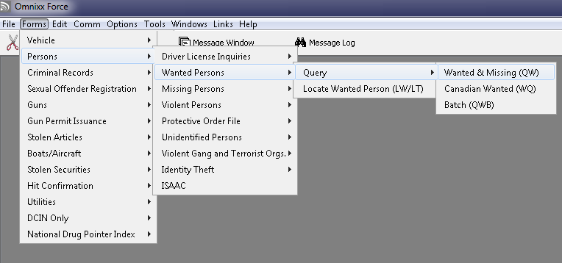
Wanted Person
TRANSACTION LOCATION

Slide 18
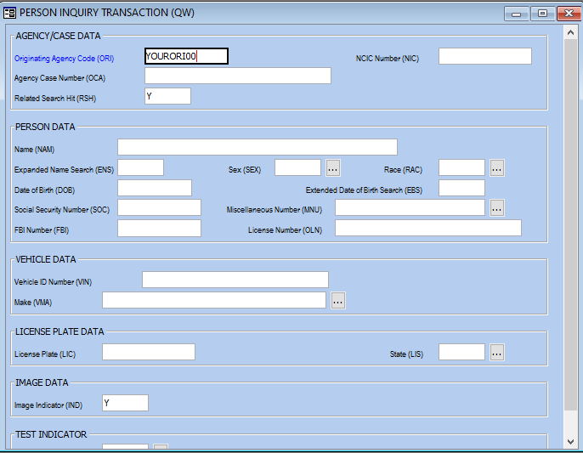
QW
SMITH,BOBBI JO
F
W
03131989
Notes:
Review Form Help and Field Help
Point out RSH, ENS, and IND fields previously discussed.

Slide 19
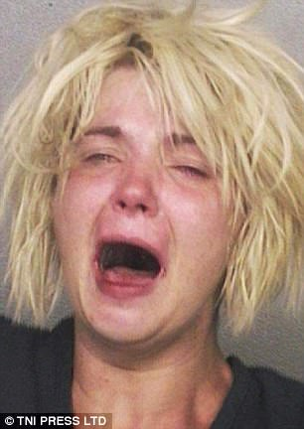
Wanted Person RESPONSE
MKE/WANTED PERSON – CAUTION ARMED AND DANGEROUS
EXL/3 EXTRADITION - SURROUNDING STATES ONLY
ORI/NC0820000 NAM/SMITH,BOBBI JO SEX/F RAC/W DOB/19890313
HGT/502 WGT/140 EYE/BLU HAI/BLN SKN/MED SMT/TAT UL ARM
SOC/245351234
OLN/4839876 OLS/NC OLY/2025
OFF/COCAINE - POSSESS
DOW/20190311 OCA/20XXTEST
WNO/2019CR12345
MIS/ARMED AND DANGER0US, KNOWN TO CARRY 9MM, EXTR FR0M SC VA TN GA 0NLY, TAT UL ARM IS BARCODE SAYS PRICELESS, ADDTL WARRANTS 0N FILE F0R MISD LARCENY
LIC/ABC987 LIS/NC LIY/2024 LIT/PC
VIN/1FAPP6047MH142942 VYR/2016
VMA/FORD VMO/EXP VST/4D VCO/BLK
ORI IS SAMPSON CO SO CLINTON 910 592-4141
NIC:W774472802

Slide 20
Wanted Person
SPIN-OFF
TO: SBITU 008128 20190315 00:07:04 005ECA7BC2
FROM: NC2K 20190315 00:07:04
*****************************************************
NO NCIC SEX OFFENDER FILE RECORD
NAM/ SMITH,BOBBI JO
DOB/ 19890313
******************** END OF MESSAGE *****************

Slide 21
Wanted Person
SPIN-OFF
TO: SBITU 008128 20190315 00:07:04 005E2ABF17
FROM: CHPINQ 20190315 00:07:04
Completion Code: HIT000000
NO HIT (QCG)
*****************************************************This Concealed Handgun Permit Response Is Based On Input Of:
Name: SMITH,BOBBI JO
Date Of Birth: 03-13-1989
**********************END OF RECORD*****************

Slide 22
Wanted Person
SPIN-OFF
TO: SBITU 001733 20190315 00:07:07 005E2ABF17
FROM: SORINQ 20190315 00:07:07
Completion Code: HIT000000
NO HIT (QSO)
***************************************************
SOR Response Is Based On Input Of:
Name: SMITH,BOBBI JO
Birthdate: 03-13-1989
****************** END OF MESSAGE ****************

Slide 23
Wanted Person
SPIN-OFF
North Carolina Department of Adult Corrections File – DAC
Name Race/Eth Sex DOB
SMITH,BOBBI JO White/Not Hispanic Female 1989-03-13
Height Weight Eye Color Hair Color
5’02 140 Blue Blonde
SMT
TAT UL ARM/SCAR ABDOMEN
AKA
NAME: SMITH, BARBARA
SID FBI DAC OLN
NC0846841A 459864MB6 1039730 NC4839876
**If incarcerated, facility would be listed here.**
DAC Discharged Inmate: 07/17/2018
DAC Discharged Probation/Parole: 10/14/2019

Slide 24
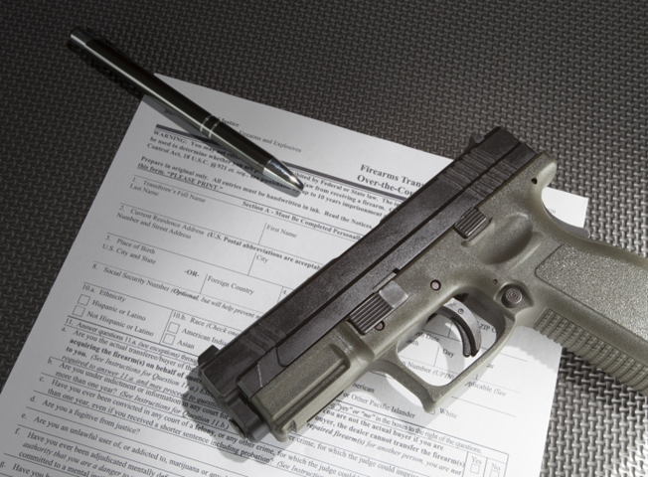

NICS Denied Transaction File
National Instant Criminal Background Check System
QW may result in spin-off
Notification of denied firearms transaction
No hit confirmation
May contact denying agency

Slide 25
NICS Denied File Response Example
NOTICE: DO NOT DETAIN OR ARREST BASED ON THIS HIT. THE DATE OF NATIONAL INSTANT CRIMINAL BACKGROUND CHECK SYSTEM (NICS) DENIAL (DND) PROVIDED IN THIS RECORD IS THE DATE THE SUBJECT WAS DENIED BY THE NICS FROM THE RECEIPT AND/OR THE POSSESSION OF A FIREARM OR THE ISSUANCE OF A FIREARMOR EXPLOSIVES PERMIT PURSUANT TO STATE AND/OR FEDERAL LAW.
HOWEVER, IT IS POSSIBLE THIS SUBJECT MAY NO LONGER BE A PROHIBITED PERSON. DISSEMINATION OF SUPPLEMENTARY INFORMATION BY THE DENYING AGENCY MAY BE LIMITED UNDER STATE OR FEDERAL LAW.
MKE/NICS DENIED TRANSACTION FILE
ORI/NC1050000 NAM/SMITH,DANIEL SEX/M RAC/U POB/NC
DOB/19950419 HGT/601 WGT/180 CTZ/US
SOP/NC SOR/NC DND/20220520
NTN/162H84VBL
NIC/E543213252 DTE/20220520 1233 EDT DLU/20220520 1233 EDT
*** THE INFORMATION DISPLAYED IN THIS RECORD IS A POSSIBLE MATCH TO THEINDIVIDUAL QUERIED. THIS MATCH IS BASED ON NAME AND DESCRIPTIVE DATA ONLY.NO LAW ENFORCEMENT ACTION SHOULD BE INITIATED BASED SOLELY ON THISINFORMATION.

Slide 26
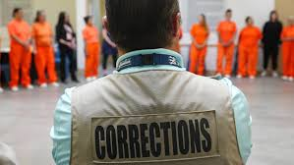
Query Corrections Transaction
Used To:
Retrieve/View DAC records
Obtain photos, probation/parole status, other descriptors
Query By:
DAC Number
FBI or SID Number
Access other participating state records
Name and Other Numerical
Notes:
DAC is a QW spin-off, but CPQ is direct inquiry.

Slide 27
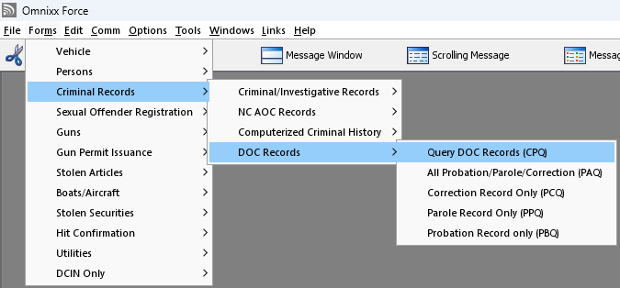
Query Corrections
TRANSACTION LOCATION

Slide 28
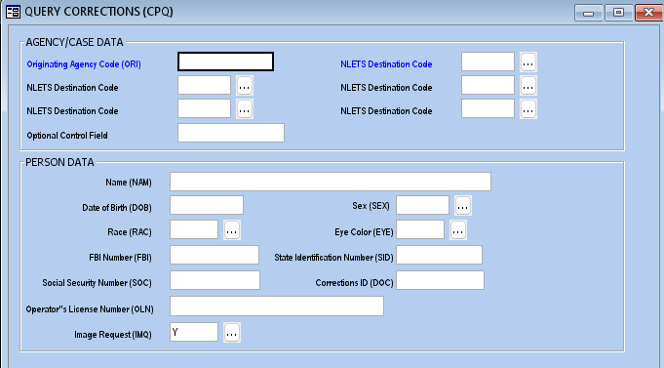
CPQ
Notes:
Age searches +/- 1 year
Height searches +/- 3 inches
Weight searches +/- 10 pounds

Slide 29

Identity Theft File
Victims of identity theft
  Determine if victim or offender
  Prevent false arrest
  Password utilized
NIC
Name and OCA
Name and DOB, FBI, MNU, and/or SOC

Slide 30
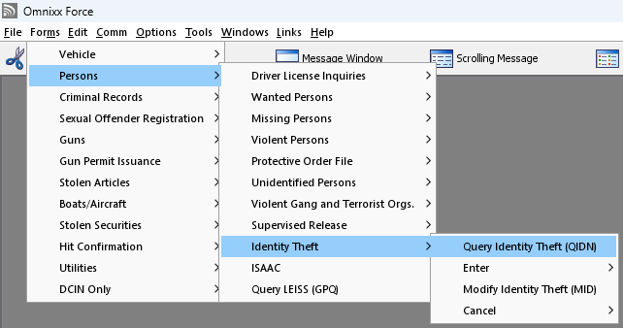
Identity Theft
TRANSACTION LOCATION

Slide 31
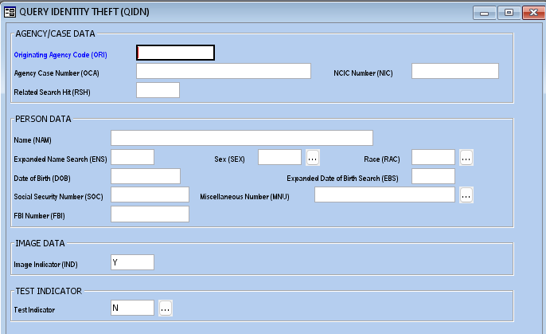
QIDN
Notes:
Age searches +/- 1 year
Height searches +/- 3 inches
Weight searches +/- 10 pounds

Slide 32
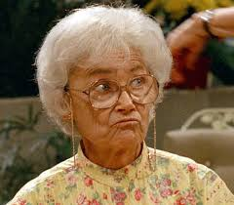
Identity Theft File Response Example
WARNING - THE IDENTITY OF THE SUBJECT IDENTIFIED IN THIS RECORD HAS BEEN REPORTED STOLEN. PLEASE REVIEW THE VICTIM PROFILE AND USE CAUTION IN VERIFYING THE IDENTITY OF THIS PERSON.
MKE/IDENTITY THEFT
ORI/MD1012600 NAM/PETRILLO,SOPHIA SEX/F RAC/W POB/MD
DOB/19230531
DOE/20040519 HGT/411 WGT/098 EYE/BLU HAI/WHI SKN/LGT SMT/SC R HND
FPC/121011CO141159TTCI13 MNU/AS-326141811 SOC/212665660
OCA/123456
MIS/IDENTITY HAS BEEN USED IN CREDIT CARD FRAUD
PWD/T45*D8#9 IDT/CFRD
ORI IS ANY CITY PD 410 555-5555
NIC/J123456789 DTE/20050505
*****WARNING - STANDING ALONE, NCIC IDENTITY THEFT FILE INFORMATION DOES NOT FURNISH GROUNDS FOR THE SEARCH AND SEIZURE OF ANY INDIVIDUAL, VEHICLE, OR DWELLING.*****
ATTENTION - THE FOLLOWING MUGSHOT/FINGERPRINT IS ASSOCIATED WITH A VICTIM OF AN IDENTITY THEFT RECORD. PLEASE BE AWARE THAT THE MUGSHOT/FINGERPRINT SPECIFIES THE VICTIM AND NOT THE OFFENDER.

Slide 33

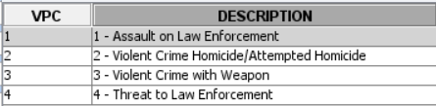
Violent Person File
Provide LEO with immediate notification of person with violent criminal history or previously threatened law enforcement
Spin-off only
Notes:
Codes 1, 2, 3 correspond to a conviction.
Code 4 may vary depending on agency definition/policy.

Slide 34

Violent Person File Response Example
WARNING-THE SUBJECT IN THIS RECORD HAS BEEN IDENTIFIED AS A VIOLENT OFFENDER. THE SUBJECT HAS A CRIMINAL HISTORY OF ASSAULTING LAW ENFORCEMENT OFFICERS. USE CAUTION IN APPROACHING THIS INDIVIDUAL. DO NOT ARREST OR DETAIN BASED SOLELY UPON THIS INFORMATION.
MKE/VIOLENT PERSON
ORI/NC0530000 NAM/SMITH,BOBBI J SEX/F RAC/W POB/TX DOB/19890313
HGT/502 WGT/135 EYE/BLU HAI/BLN FBI/123456789 CTZ/US SKN/MED
SMT/TAT UL ARM
FPC/121011CO141159TTCI13 MNU/AS-123456789 SOC/123456789
OLN/11111111 OLS/NC OLY/2023
VPC/3-VIOLENT CRIME WITH WEAPON
OCA/123456273
MIS/CONVICTED OF AWDW KNIFE
LIC/ABC123 LIS/NC LIY/2018 LIT/PC
VIN/2Y27H5LI00009 VYR/1975
VMA/PONT VMO/VEN VST/2D VCO/BLU
ORI IS LEE COUNTY SHERIFFS OFFICE 555-555-5555
NIC/L146203706 DTE/20171204 DLU/20171204

Slide 35

Blue Alert Notification
Quickly notifies law enforcement and public when:
LEO killed or seriously injured
Subject on the run
NC Center for Missing Persons
NCIC record responses should have ‘BLUE ALERT’ caveat at top

Slide 36
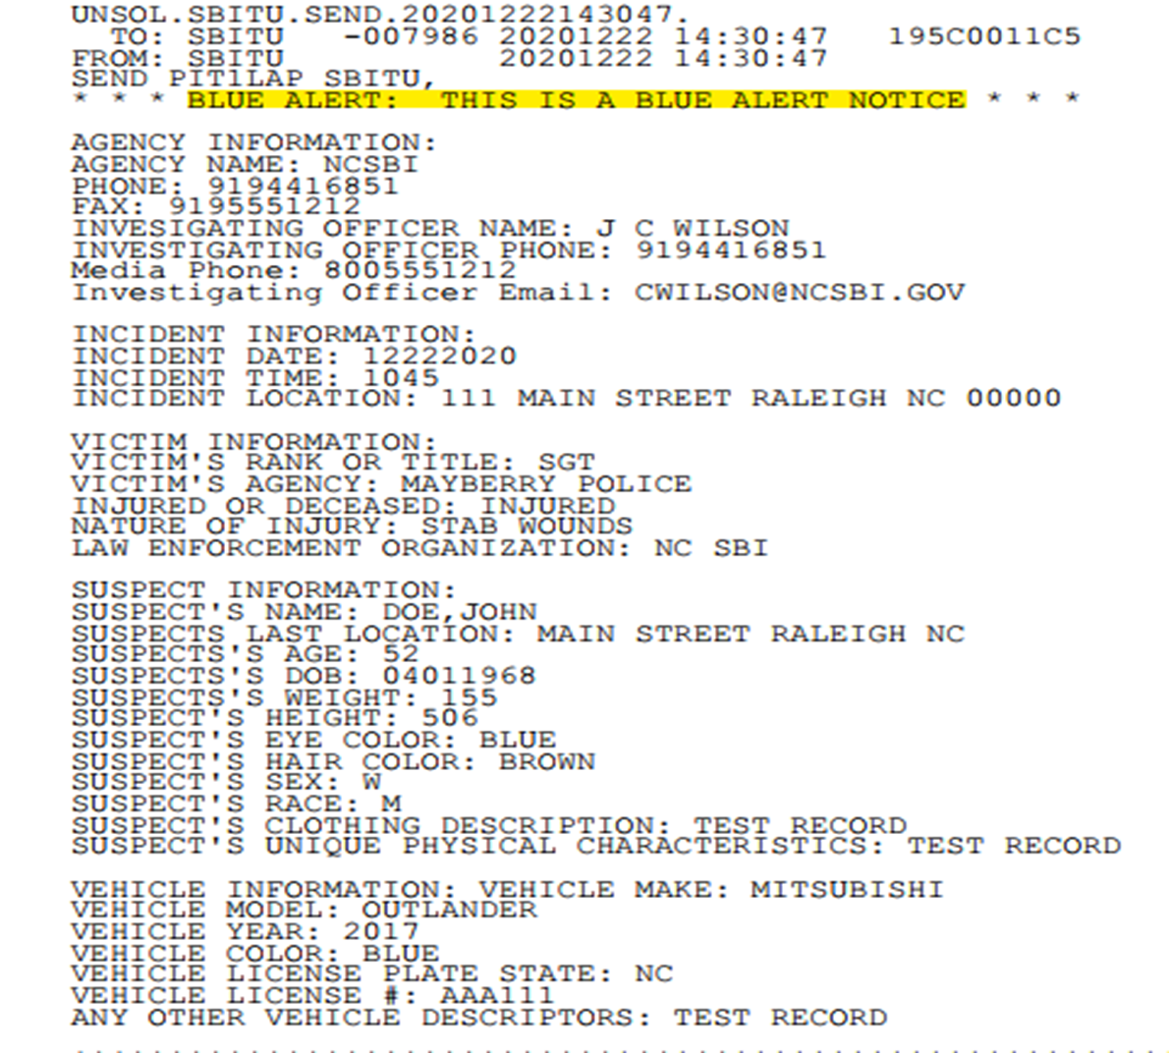
Blue Alert Example

Slide 37
WP with BLUE ALERT Response Example
MKE/WANTED PERSON
BLUE ALERT WARNING. USE EXTREME CAUTION IN APPROACHING THIS INDIVIDUAL.
EXL/1 - FULL EXTRADITION
ORI/NCBCI0000 NAM/BUNNY,BUGS SEX/M RAC/U POB/CA
DOB/19400727 HGT/600 WGT/200 EYE/ BLK HAI/GRY FBI/1234567A1 CTZ/US
SKN/ALB
OFF/AGGRAV ASSAULT
DOW/ 20210106 OCA/L1440720
NOA/N
MIS/BLUE ALERT FIRED MULTIPLE ROUNDS UZI SUBMACHINE GUN AT DEPUTY
DNA/N
ADD/01 - RESIDENCE (LAST KNOWN)
SNU/123 SNA/MAIN STREET
CTY/RALEIGH
COU/WAKE
ORI IS STATE BUREAU OF INVESTIGATION RALEIGH 919 662-4500
LIC/BUGSY LIS/CA LIY/1969 LIT/PC
VMA/FORD VMO/MUS VST/2D VCO/RED
AKA/WABBIT,WASCALLY
AKA/BUNNETT,ROBERT
NIC/ W00232132 DTE/20210106 1944 EST DLU/20210106 1944 EST

Slide 38
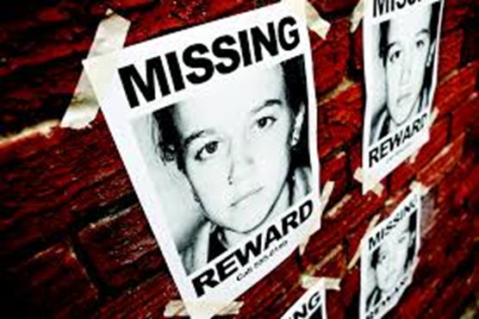
Missing Person File
QW
QM
OR
Name
and
numerical identifier
Physical
descriptors
Up to 20 responses
Notes:
Always use QW when you have name and numerical identifier, QM is an option when you don’t have a name or numeric. Example, when the subject is unable to give you their name and numerical identifier (small child, elderly, etc.), you can query using their physical descriptors (what you see: height, weight, hair color, eye color, etc.) QM will only check the Missing Person File nothing else.

Slide 39
Missing Person File
CATEGORIES
DISABLED
ENDANGERED
INVOLUNTARY
CATASTROPHE VICTIM
OTHER
JUVENILE RUNAWAY
Notes:
Review categories.

Slide 40
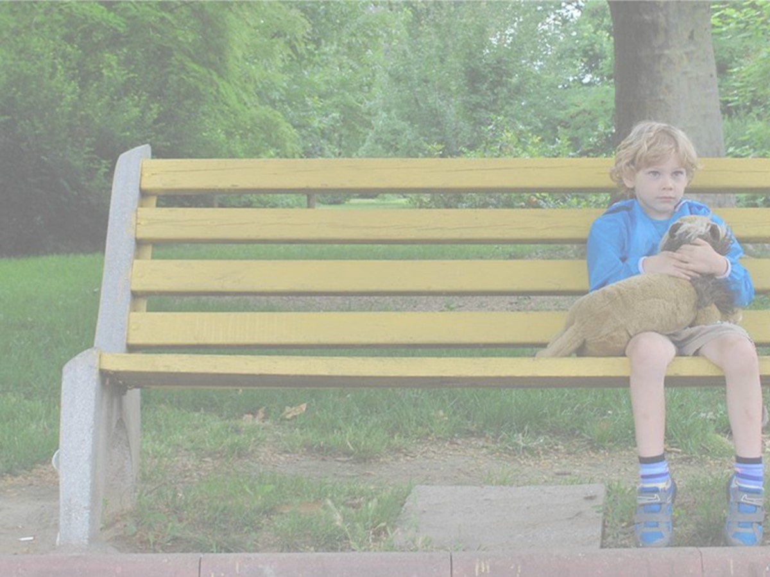
Missing Person
SCENARIO
A young child has been found abandoned at a local park.
He appears to be traumatized and is unwilling to talk to strangers.

Slide 41
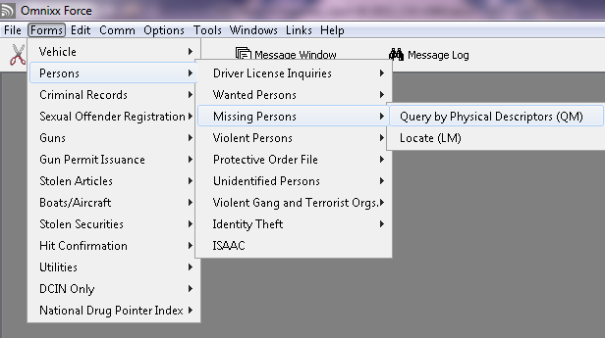
Missing Person
TRANSACTION LOCATION

Slide 42
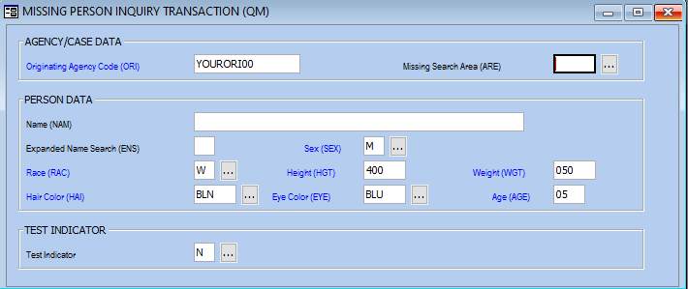
QM
Notes:
Age searches +/- 1 year
Height searches +/- 3 inches
Weight searches +/- 10 pounds

Slide 43
Missing Person
RESPONSES
NCIC HAS 0018 POSSIBLE MATCHES FOR YOUR INQUIRY. THE TWO HIGHEST SCORING RECORDS ARE LISTED FOLLOWED BY THE NIC NUMBERS OF UP TO 20 OF THE HIGH SCORE RECORDS.
MKE/MISSING PERSON – ENDANGERED
ORI/NY0270000 NAM/JONES,KELLY SEX/M RAC/W
DOB/20030920 HGT/406
WGT/050 EYE/BLU HAI/BLN
MNP/CA DLC/20081123 OCA/08J002460
MIS/STRANGER ABDUCTION, WEARING BLUE TANK T0P AND WHITE SH0RTS
ORI IS MONROE CO SHERIFF'S DEPT ROCHESTER NY 716 428-5209
NIC/M738159594 DTE/20081123 0905EST
IMMED CONFIRM MISSING PERSONS STATUS WITH ORI
MKE/MISSING PERSON - INVOLUNTARY
ORI/VA1280100 NAM/SMITH,JONATHAN SEX/M RAC/W POB/VA
DOB/20100531 HGT/404 WGT/042 EYE/BLU HAI/BLN
MNP/MP DLC/20151213 OCA/05029289
MIS/TAKEN BY HIS M0THER
ORI IS VIRGINIA BEACH PD VA 757 427-8175
NIC/M711014398 DTE/20151213 0101EST
IMMED CONFIRM MISSING PERSONS STATUS WITH ORI

Slide 44
Missing Person
RESPONSES
Continuation of NICS for 18 possible Missing Person matches:
M738159594 090 M711014398 081 M743899930 072 M692384907 070
M756547710 068 M740264649 064 M745275380 060 M677451601 057
M612174121 055 M670452968 055 M762325667 045 M390489481 044
M537150035 044 M578827217 040 M755272480 040 M642389885 030
M611174321 026 M576342543 024

Slide 45
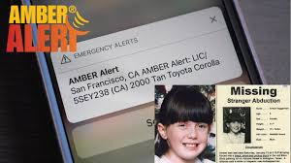
Missing Person
AMBER ALERT
17 or younger
Abducted
Routed statewide to all terminals
Forward per your department policy
Notes:
NC Center for Missing Persons

Slide 46
* * * AMBER ALERT: THIS IS A CHILD ABDUCTION NOTICE * * *
Agency CUMBERLAND COUNTY SHERIFFS OFFICE, NC0260000, at 9195551212, is searching for GRACE LEDFORD, with NCIC identifier M354236746.
NCIC Image entered? Y
The victim is a(n) BLACK FEMALE, age approximately 08 years old. He/She is about 403 (Xfeet/XXinches) tall and weighs 065 pounds. He/She has BROWN hair color and BROWN eyes.
The following case information is provided:
GRACE WAS ABDUCTED ON THE CORNER OF FIFTH AND MAIN IN MAYBERRY AT 8:30 AM MONDAY. SHE WAS WEARING PINK PANTS, A WHITE BLOUSE AND A PURPLE JACKET. Police are looking for GEORGE CASEY, who is a(n) WHITE MALE. His age is approximately 65. The description of the suspect’s vehicle is: BLUE 1998 OLDSMOBILE CUTLASS WITH LOUD MUFFLER AND DARK TINTED GLASS where license plate is ABC1234 and the license state is NC.
URGENT - Telecommunicators: Please broadcast this message per your department policy and forward this message to the MDT’s within your jurisdiction

Slide 47
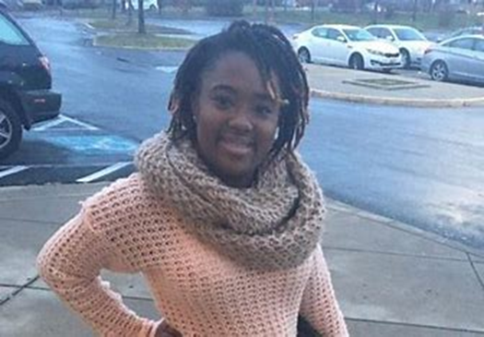
Missing Person
ASHANTI ALERT
Adults 18-64
Abducted
Routed statewide to all terminals
Forward per your department policy
Notes:
NC Center for Missing Persons

Slide 48
Missing Person
MISSING ENDANGERED ALERT
For missing persons age 64 or younger
Includes children with cognitive impairments
Must have dementia, Alzheimer’s, or similar condition
Notes:
NC Center for Missing Persons

Slide 49
Missing Person
Silver ALERT
Missing adult with cognitive impairment
(e.g., Alzheimer’s, dementia)
Must be 65+ and reported missing within 72 hours
At risk of harm, abuse, neglect, or exploitation
Notes:
NC Center for Missing Persons

Slide 50
Missing Person
Weather ALERT
Missing person, of any age, during an extreme weather
(e.g., extreme heat, extreme cold, significant weather event)
Reported missing within 72 hours
On foot, not in a vehicle
Notes:
NC Center for Missing Persons

Slide 51
Unidentified Person File
Identity cannot be established
Query by physical descriptors or body part status
Unidentified Deceased
Unidentified Catastrophe Victim
Unidentified Living
Notes:
Examples: amnesia victim, infant, deceased person

Slide 52
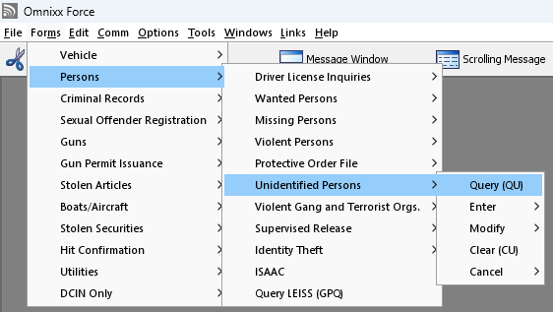
Unidentified Person File
TRANSACTION LOCATION

Slide 53
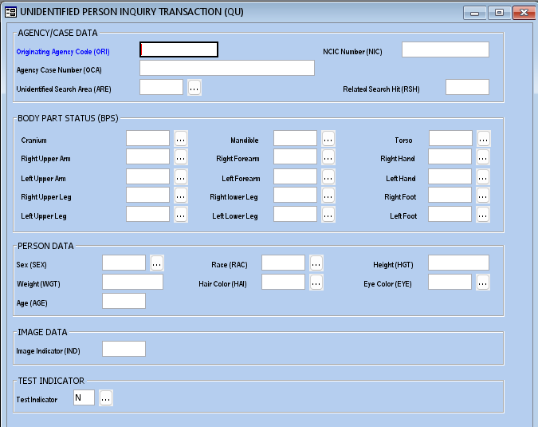
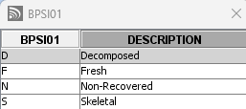
QU
Notes:
ARE – Can be a state code or regional code listed

Slide 54
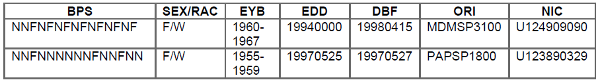
Unidentified Person Response Example
FOLLOWING ARE ABBREVIATED RECORDS WHICH MATCH YOUR INQUIRY ON: BPS/FFNNNNNNNNNNNNN, SEX/F, ARE/PA
Notes:
BPS = Body Part Status (codes correspond to pic on previous slide)
EYB = Estimated Year of Birth
EDD = Estimated Date of Death
DBF = Date Body Found

Slide 55
Gang File &
Threat Screening Center File
Gang File
QGG
QGM
Threat Screening Center File
Terrorists
Transnational Organized Crime
No hit confirmation
No dissemination to private attorneys or ‘P’ ORIs
Do NOT alert individual

Slide 56
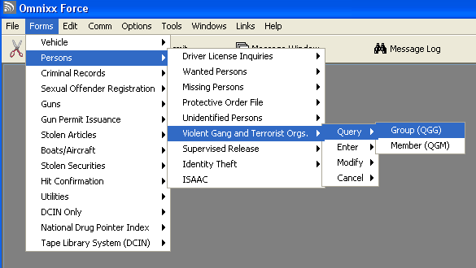
Gang File
TRANSACTION LOCATION

Slide 57
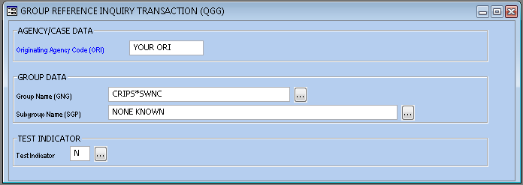
QGG

Slide 58
Gang File
GROUP RESPONSE
MKE/CRIMINAL GANG
GNG/CRIPS*SWNC SGP/NONE KNOWN
CONTACT AGENCIES:
NC0450000 DOUG HILL GANG TASK FORCE 828-694-2788
NC0670012 SGT,BARRON 910 989-4067
DTE/20180715 1441 EDT DLU/20181219 1301 EDT
TTO/TAT NECK BROKEN
DRS/BLUE CLOTHING
HND/5 POINT STAR DOWN
GTI/CRIP BLUE PAINT
MIS/MULTIPLE TATS ARMS WEB OF THE HANDS 6 POINT STAR
CONTACT AGENCIES LISTED FOR FURTHER INFORMATION ON THIS GANG

Slide 59
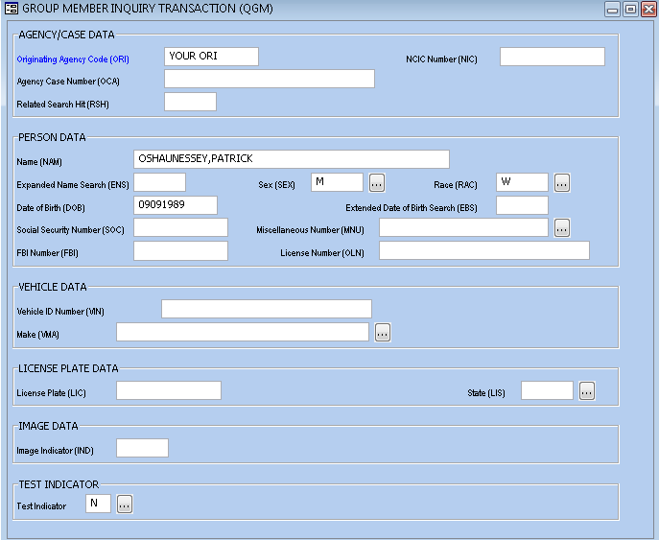
QGM

Slide 60
Gang File
MEMBER RESPONSE
WARNING - STANDING ALONE, NCIC GANGS/THREAT SCREENING FILE INFORMATION DOES NOT FURNISH GROUNDS FOR THE SEARCH OR SEIZURE OF ANY INDIVIDUAL, VEHICLE, OR DWELLING.
MKE/VIOLENT GANG MEMBER - CAUTION
EXPLOSIVE EXPERTISE
ORI/NC0260000 NAM/0SHAUNESSEY,PATRICK GREENE SEX/M RAC/W DOB/19890909
HGT/600 WGT/190 EYE/GRN HAI/BR0 SKN/FAR SMT/TAT UL ARM
GNG/CELTIC GUARD*RLNC SGP/N0NE KN0WN
ECR/A DOP/20231212 OCA/TEST
MIS/TRAINED IN EXPLOSIVES KNOWN TO CARRY C4 TAT UL ARM IS CELTIC CR0SS
ORI IS CUMBERLAND CO SO 910 555-5555
NIC/T360016603 DTE/20181212 1858 EST

Slide 61
Threat Screening Center File
RESPONSE
***LAW ENFORCEMENT SENSITIVE INFORMATION***
***WARNING – APPROACH WITH CAUTION***
***DO NOT ADVISE THIS INDIVIDUAL THAT THEY MAY BE ON A TERRORIST WATCHLIST***
CONTACT THE THREAT SCREENING CENTER (TSC) AT (866) 872-9001 DURING THIS ENCOUNTER. IF THIS WOULD EXTEND THE SCOPE OR DURATION OF THE ENCOUNTER, CONTACT THE TSC IMMEDIATELY THEREAFTER. IF YOU ARE A BORDER PATROL OFFICER, IMMEDIATELY CALL THE TSC.
WITHOUT OTHERWISE EXTENDING THE SCOPE OR DURATION OF THE ENCOUNTER, ATTEMPT TO OBTAIN SUFFICIENT IDENTIFYING INFORMATION TO ASSIST THE TSC IN DETERMINING WHETHER OR NOT THE IDENTIFIER(S) YOU QUERIED BELONG TO AN INDIVIDUAL IDENTIFIED AS HAVING POSSIBLE TIES WITH TERRORISM. DO NOT DETAIN OR ARREST THIS INDIVIDUAL UNLESS THERE IS EVIDENCE OF A VIOLATION OR FEDERAL, STATE, OR LOCAL STATUTE(S).
UNAUTHORIZED DISCLOSURE IS PROHIBITED.
INFORMATION THAT THIS INDIVIDUAL MAY BE ON A TERRORIST WATCHLIST IS THE PROPERTY OF THE TSC AND IS PROVIDED TO YOUR AGENCY ONLY FOR INTELLIGENCE AND LEAD PURPOSES. THIS RECORD MAY INCLUDE INFORMATION THAT CAN ONLY BE USED IN A CRIMINAL PROCEEDING WITH THE ADVANCE AUTHORIZATIO OF THE ATTORNEY GENERAL OR INFORMATION WHOSE USE MAY BE RESTRICTED BY FEDERAL GOVERNMENT POLICY; ANY RECIPIENT INTERESTED IN USING THIS INFORMATION, OR ANY INFORMATION DERIVED THEREFROM, MUST FIRST CONTACT THE TSC TO OBTAIN THE NECESSARY APPROVAL.
Notes:
Khalid Mohammed – went to Chowan College and NC A&T – “principal architect of 9/11 attacks” – B.S. mechanical engineering

Slide 62
Protective Order File
Types of Orders
Ex Parte
Domestic Violence
Query by
Name & Numeric
Responses:
Active
Military
Permanent Civil No-Contact Against Human Trafficker or Sex Offender
Expired
Cleared (Dismissed)
Expiration occurs at 11:59 PM on the expiration date shown.

Slide 63
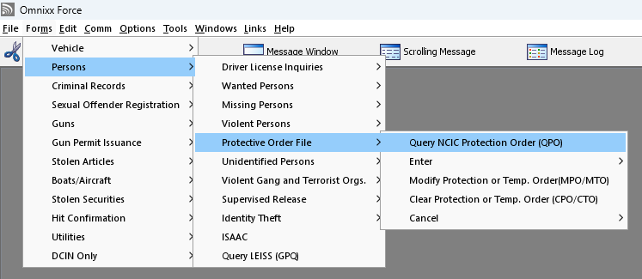
Protective Order File
TRANSACTION LOCATION

Slide 64
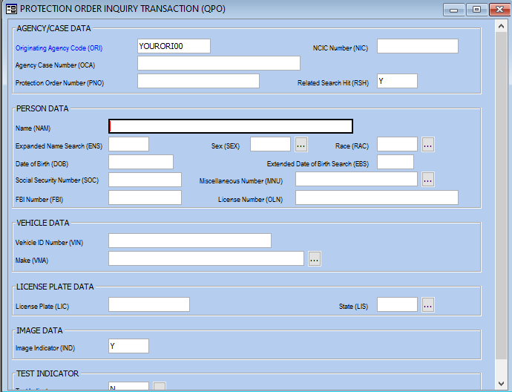
QPO
SMITH,KAREN A
F
A
03131980

Slide 65
Protective Order File
RESPONSE
**WARNING - THE FOLLOWING IS AN NCIC PROTECTION ORDER RECORD. DO NOT SEARCH, DETAIN, OR ARREST BASED SOLELY ON THIS RECORD. CONTACT ENTERING AGENCY TO CONFIRM STATUS AND TERMS OF PROTECTION ORDER**
MKE/ PROTECTION ORDER - CAUTION VIOLENT TENDENCIES
ORI/NC0260000 NAM/SMITH,KAREN A SEX/F RAC/A
DOB/19800313 HGT/509 WGT/165 EYE/BR0 HAI/BR0
OLN/987123456 OLS/NC OLY/20XX
PNO/2019CVD011234 BRD/Y ISD/20190117 EXP/20200117
PPN/SMITH,HAROLD PSX/M PPR/B PPB/19780909
PCO/ 01 - THE SUBJECT IS RESTRAINED FROM ASSAULTING, THREATENING, ABUSING, HARASSING, FOLLOWING, INTERFERING, OR STALKING THE PROTECTED PERSON AND/OR THE CHILD OF THE PROTECTED PERSON.
MIS/ DEFENDANT KNOWN TO ASSAULT OFFICERS
ORI IS CUMBERLAND CO SO FAYETTEVILLE 910 323-1500
PCO/ 05 - THE SUBJECT IS RESTRAINED FROM MAKING ANY COMMUNICATION WITH THE PROTECTED PERSON INCLUDING BUT NOT LIMITED TO, PERSONAL, WRITTEN, PCO/OR TELEPHONE CONTACT, OR THEIR EMPLOYERS, EMPLOYEES OR FELLOW WORKERS, OR OTHERS WITH WHOM THE COMMUNICATION WOULD BE LIKELY TO CAUSE ANNOYANCE OR ALARM THE VICTIM.
NIC/H099000427 DTE/20190117 2019 EST

Slide 66
Sex Offender Registration &
Public Protection File
Registration
Regular Offenders: 10-30 years
Lifetime Offenders
Violations
Class F Felony
Subject to warrantless arrest
Dissemination
Website
Sexually Violent Predators
Aggravated Offenders
Recidivists
YQSO/YRSO
Do not provide info from DCIN/NCIC
Contact Sheriff’s Office

Slide 67
Juvenile
Sex
Offenders
Registration
Must be at least 11 years old
Specific offenses
Violations
None enforceable
Dissemination
Not public record
Judge ordered
Not on website
Not in NCIC

Slide 68
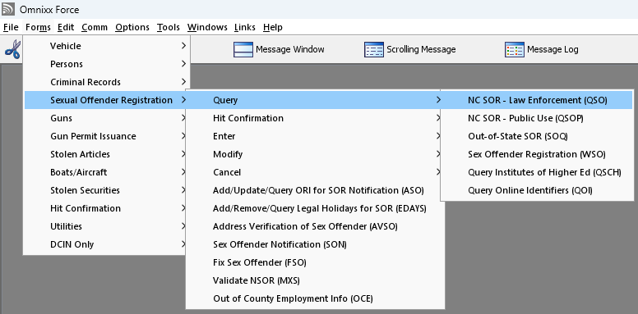
Sex Offender File
TRANSACTION LOCATION

Slide 69
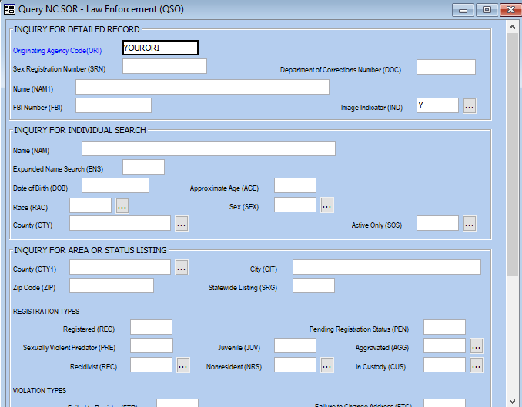
QSO

Slide 70
Sex Offender File
RESPONSE
(PART 1 OF 2)
*** AGGRAVATED OFFENDER***
Registration Status: ACTIVE Violations: FTC
Registration Date: 04-01-2012
Registration Period: MANDATORY LIFETIME
Petition Eligibility: INELIGIBLE
Registration Contact Agency: NC0920000 Wake County Sheriff’s Office
NAME: FRYE,KRISTOPHER PAUL SRN: 000998S1
123 FIRE ST County of Address: WAKE
CARY NC 99999- Address Date: 04-01-2012
CUSTODY STATUS: NOT IN CUSTODY
ALIAS NAME(S): FRYE, CHRIS P FRY, KRIS P
SID: NC234567A FBI: 994482XA0 DNA:YES
Drivers License/ID: 9876542 NC
Race/Sex: WHITE/MALE Height: 5 Ft. 09 In Weight: 188 lbs
Hair: BROWN Eyes: BROWN
Birth Date: 02-02-1964
Scars, Marks, Tattoos: SC L ARM 6 INCH CURVED SCAR

Slide 71
Sex Offender File
RESPONSE
(PART 2 OF 2)
* * * OFFENSE AND CONVICTION INFORMATION * * *
OFFENSE NUMBER: K002 Registration Key: R01
Date of Registration: 04-01-2012 Registering County: Wake
Date Of Conviction: 12-31-2007 Date Of Release: 03-29-2012
Date of Offense: 05-11-2007 Victim Age: 14
NC Statute: 14-178 - INCEST BETWEEN NEAR RELATIVES
Court County: ANSON COURT CASE: 2008CRS123
Sentence Imposed: Confinement/ 5Y - 8Y
OFFENSE NUMBER: K001 Registration Key: R01
Date Of Registration: 04-01-2012 Registering County: Wake
Date Of Conviction: 12-31-2007 Date Of Release: 03-29-2012
Date of Offense: 05-11-2007 Victim Age: 14
CONVICTION FOR AGGRAVATED OFFENSE
NC Statute: 14-27.2 - RAPE 1ST DEGREE
Court County: Anson Court Case:2007CRS998877
Sentence Imposed: Confinement/ 5-15yrs
* END OF RECORD *

Slide 72
NC Concealed Handgun Permit File
NC residents meeting certain criteria
Issued by Sheriff’s Office
Must carry permit and valid identification
Permit valid for 5 years
Not public record

Slide 73
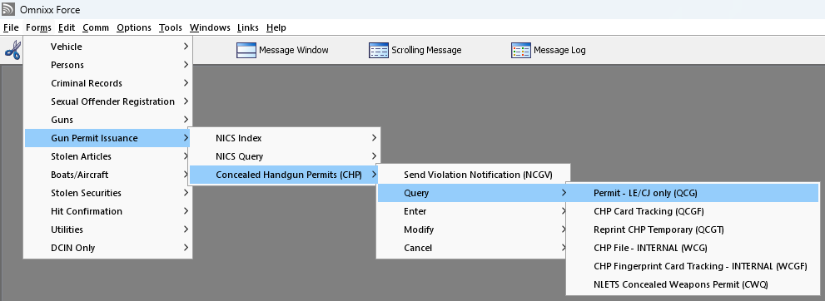
NC Concealed Handgun Permit File
TRANSACTION LOCATION

Slide 74
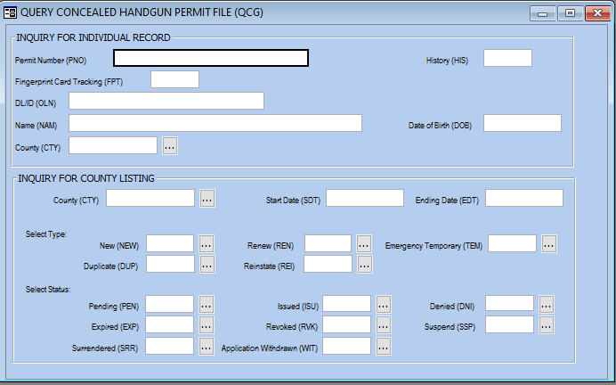
QCG

Slide 75
NC CHP File
RESPONSE
Permit Number: NC222426
Name: GUNSLINGER,ANTHONY STEVEN
Address: 987 EVERGREEN CHURCH ROAD
PEMBROKE, NC 28372
Driver License: 8571234 License State: NC
Social Security Number: 245-45-6543 Phone: (910) 521-0123
Date Of Birth: 08-15-1974 Race/Sex: White/Male County: ROBESON
Military Status: Not Applicable
Height: 5 Ft. 10 In. Weight: 200 Lbs. Eyes: BROWN Hair: BROWN
ORI: NC0780000 ROBESON CO SO
*******************************************************************
Current Status of Permit:
Type: NEW Status: ISSUED
Issued: 09-24-2020 Expiration: 09-23-2025
*******************************************************************
Additional Status Records Here

Slide 76
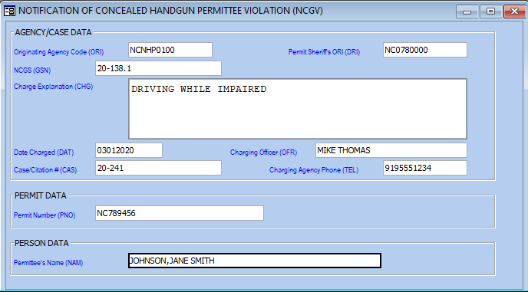
Notification: Possible CHP Violation
NCGV

Slide 77
NCGV
RESPONSE
* NOTIFICATION OF CONCEALED HANDGUN PERMITTEE POSSIBLE VIOLATION *
TO: NC0780000 - ROBESON COUNTY SHERIFF'S OFFICE
FROM: NCNHP0100-STATE HIGHWAY PATROL - TROOP A - WILLIAMSTON
ATTN SHERIFF: THIS IS TO ADVISE YOU THAT THE BELOW INDIVIDUAL HAS BEEN CHARGED WITH A VIOLATION OF THE CONCEALED HANDGUN LAW OR OTHER LAW WHICH MAY AFFECT THEIR RIGHT TO CONTINUE POSSESSION OF THEIR CONCEALED HANDGUN PERMIT.
PERMITTEE NAME: JOHNSON, JANE SMITH
PERMIT NUMBER: NC789456
NCGS: 20-138.1 CHARGE EXPLANATION: DRIVING WHILE IMPAIRED
DATE CHARGED: 03012020 CHARGING OFFICER NAME: MIKE THOMAS
CASE/CITATION #: 20-241 CHARGING AGENCY PHONE: 9195551234
IF YOU DESIRE COPIES OF THE INVESTIGATIVE REPORTS, CITATIONS, ETC.,
CONTACT THIS AGENCY DURING NORMAL BUSINESS HOURS.
* END OF RECORD *

Slide 78
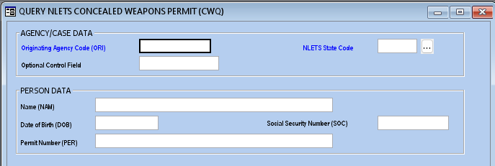
Reciprocity & Out-of-State CHP
CWQ
NC recognizes all other states’ valid CHPs

Slide 79
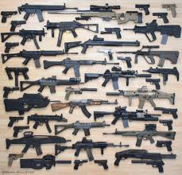
Gun Inquiry
Stolen Guns
Recovered Guns
Lost
Guns
Felony Guns
Notes:
Must have serial number!

Slide 80
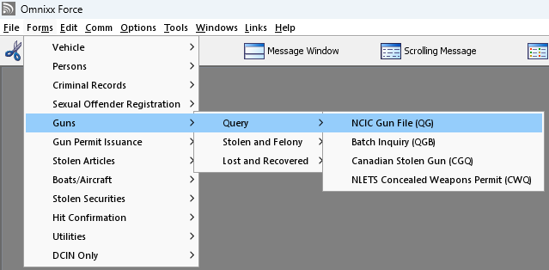
Gun Inquiry
TRANSACTION LOCATION

Slide 81
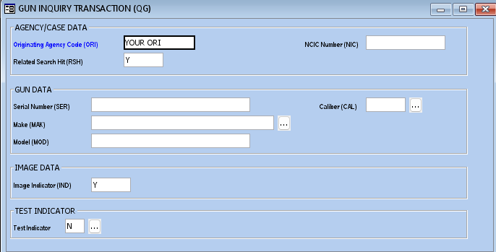
QG
7112
45
SPR

Slide 82
Gun Inquiry
RESPONSE
MKE/STOLEN GUN
ORI/NC0090000 SER/7112 MAK/SPR CAL/45
TYP/PR DOT/20180319
OCA/1101234
NIC/G710487243 DTE/20180319 1555 EST
ORI IS BLADEN CO SO ELIZABETHTOWN 910 862-6960
IMMED CONFIRM RECORD WITH ORI
***RELATED RECORDS***
MKE/STOLEN GUN
ORI/NC0090000 SER/4987 MAK/GLC CAL/9
TYP/PI DOT/20180319
OCA/1101234
NIC/G480477570 DTE/20180319 1555 EST
ORI IS BLADEN CO SO ELIZABETHTOWN 910 862-6960
IMMED CONFIRM RECORD WITH ORI

Slide 83
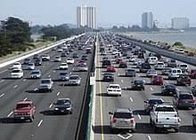
Vehicle Inquiry
Stolen Vehicle
Felony Vehicle
Recovered Vehicle
Stolen License Plate
Stolen Part

Slide 84
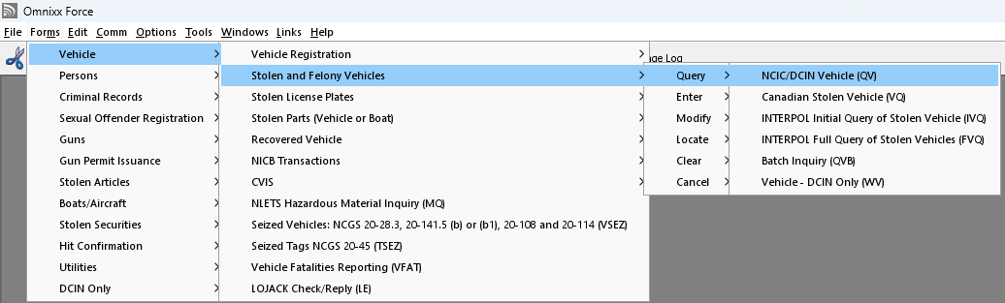
Vehicle Inquiry
TRANSACTION LOCATION

Slide 85
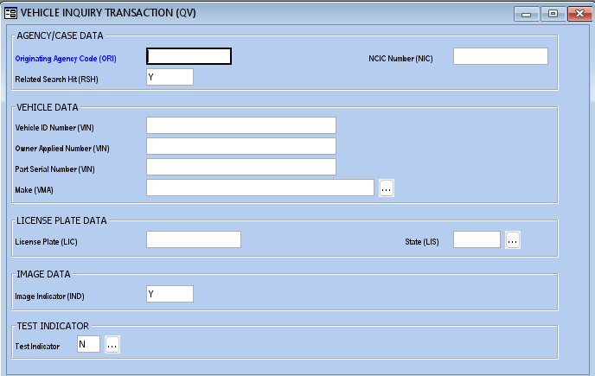
QV

Slide 86
Vehicle Inquiry
RESPONSE
MKE/STOLEN VEHICLE
ORI/NC0090000 LIC/6E4291 LIS/NC LIY/2017 LIT/MC
VIN/1HD1BHY1X6Y055266 VYR/2006
VMA/HD VMO/CYL VST/MC VCO/BLK DOT/20201026
OCA/2020-1811
VLD/20230214
MIS/TAKEN FR0M 549 NC 410 DUBLIN 0WNER J0HNNY DEAN BRYAN 3230 GUYT0N RD MIS/BLADENB0R0 SUSP VEH GREEN SUBURBAN IF L0CATED C0NTACT BLADEN C0 S0 AUTH C0RP
MIS/ D MILLER KSJ
OPT/OUT
NIC/V012451792 DTE/20201027 1956 EDT DLU/20230214 1506 EDT
ORI IS BLADEN CO SO ELIZABETHTOWN 910 862-6960 IMMED CONFIRM RECORD WITH ORI

Slide 87
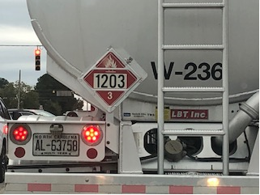
Hazardous Materials Query
4 digit placard number
Responses include:
  Chemical name
  Safety precautions
  Handling/disposal procedures
  Public health hazards
Notes:
Information same as US DOT Emergency Response Guidebook
Also an app available called ERG2024

Slide 88
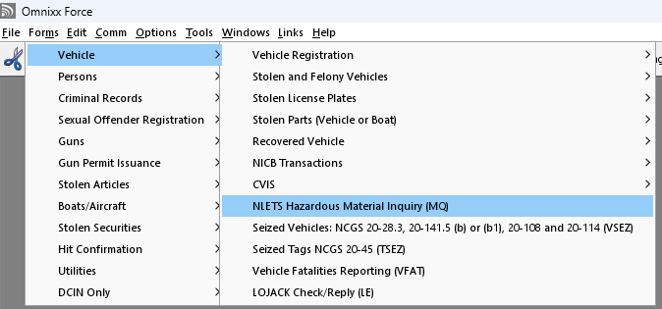
Hazardous Materials Query
TRANSACTION LOCATION

Slide 89
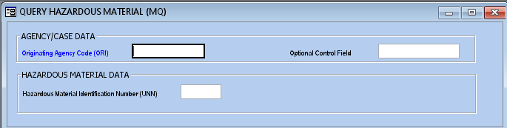
MQ
Notes:
Response to long to include in presentation.

Slide 90
Stolen Boat Query
- Vessel designed for transport by water
- Constructed to provide buoyancy by excluding water
- Shaped to give stability and permit propulsion
Query by:
Hull Number
Registration Number
Searches:
Stolen Boats
Stolen Vehicles
Stolen Parts

Slide 91
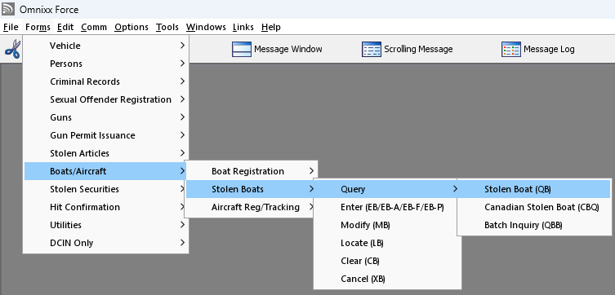
Stolen Boat Query
TRANSACTION LOCATION

Slide 92
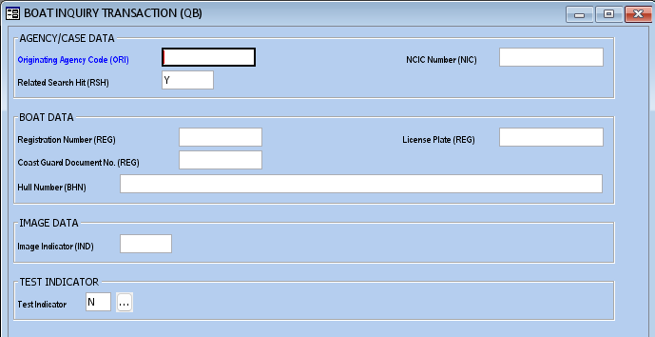
QB

Slide 93

Stolen Boat
RESPONSE
MKE/STOLEN BOAT
ORI/MD1012600 REG/MD1235ZZ RES/MD REY/1999 HUL/WD BHN/LBC123450874 BYR/1974 PRO/OB BMA/WEL BTY/RUN BLE/17 BCO/RED DOT/19981105
OCA/A222
MIS/BLUE STRIPING
NIC/B000032685 DTE/19981110 0000 EST DLU/19981215 0000 EST
ORI IS ANY CITY PD MD 301 555-1234

Slide 94
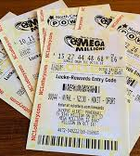


Stolen Article Query
Property that does not fit into the other files
Query By:
  Serial Number
  Owner Applied Number
  NIC

Slide 95

Stolen Article Query
TRANSACTION LOCATION

Slide 96

QA

Slide 97

Stolen Article
MKE/STOLEN ARTICLE
ORI/NC0120600 TYP/LCATTLE SER/1892 BRA/CATTLE
MOD/CALFM OAN/OC212 DOT/20250630
OCA/2025-567
MIS/MALE CALF BLK WITH WHT SPOTS AND LEGS
DTE/20250701 0115 EDT DLU/20250701 0115 EST
ORI FARMLAND PD 252-555-1212
Notes:
MOD shows Male Calf

Slide 98

Stolen Security Query
Negotiable and exchangeable for cash
Query by:
  Type
  Serial Number
  Denomination
  Issuer/Owner
  Social Security Number
  NIC

Slide 99

Stolen Security Query
TRANSACTION LOCATION

Slide 100

QS

Slide 101

Stolen Security
RESPONSE
MKE/STOLEN SECURITY
ORI/MD1012600 TYP/BD SER/D30232 DEN/1000 ISS/CON EDISON OWN/POWELL, JOSEPH SDT/M19971004 DOT/19981205 OCA/12343432
NIC/S178628175 DTE/19981205 0000 EST DLU/19990801 0000 EDT ORI IS ANY CITY PD MD 301 555-1212

Slide 102

Canadian Police Information Centre
Persons
(WQ)
Vehicles
(VQ)
Boats
(CBQ)
Guns
(CGQ)
Articles
(CAQ)
Securities
(CSQ)
Requires reason code and if in-sight
Hit confirmations handled by INTERPOL

Slide 103
Hit Confirmation Procedures
Required 24/7
Confirming means:
  Contacting entering agency
  Ensuring person/property is a match
  Ensuring record is still valid
YQ
Urgent
Routine
YR
Response
Locate
Finding Agency
Entering Agency
Finding Agency
Indicates person/property found/apprehended

Slide 104

Hit Confirmation
TRANSACTION LOCATION

Slide 105


YQ

Slide 106


YR

Slide 107

Hit Confirmation
EXCEPTION #1
Canadian Files

Slide 108

Hit Confirmation
EXCEPTION #2
Contact LESC
Immigration Violator Files

Slide 109


Hit Confirmation
SCENARIO
While on patrol, an officer makes a traffic stop. She decides to see if the driver is wanted. A positive hit is received and she asks you to confirm the NCIC Hit.

Slide 110

QW
First
HIDEN,BEN N
M
W
10271982

Slide 111


Slide 112

MKE/WANTED PERSON
CMC/05 - VIOLENT TENDENCIES
EXL/2 - LIMITED EXTRADITION SEE MIS FIELD
ORI/SC0100100 NAM/HIDEN,BEN N SEX/M RAC/W POB/NC
DOB/19821027 HGT/602 WGT/200 EYE/BLU HAI/BR0 CTZ/US SKN/MED
SMT/TAT UR ARM OLN/987654321 OLS/NC OLY/2021
OFF/OPIUM OR DERIV - SELL
DOW/20190213 OCA/TESTREC0213 NOA/N
MIS/KN0WN T0 ASSAULT LAW ENF0RCEMENT TAT UR ARM HEART EXTR 0NLY NC SC
DNA/N
ORI IS CHARLESTON POLICE DEPARTMENT SC
AKA/LABEOUF,SHIA
SMT/TAT UL ARM
IMN/I065235215 IMT/M
NIC/W786061898 DTE/20190213 1348 EST DLU/20190213 1352 EST IMR/MUGSHOT IMAGE

Slide 113


Slide 114


Slide 115
Hit
Confirmation
REQUEST
Received by entering agency
****HIT CONFIRMATION REQUEST - FIRST NOTICE****
****RESPONSE PRIORITY :URGENT!-
RESPOND WITHIN 10 MINUTES****
OCA/TESTREC0213. NIC/W786061898.
**WANTED PERSON**
NAM/HIDEN,BEN N .DOB/19820327.SEX/M.
NAME OF REQUESTER: SGT. JAMES GRAY
AGENCY NAME: SANFORD PD
PHONE: (919) 775-8268 EXT:228
FAX: (919) 775-8222
REMARKS: HAVE SUBJ STOPPED FOR TRAFFIC VIOL
NEED IMMEDIATE RESPONSE

Slide 116


Slide 117
Hit
Confirmation
RESPONSE
Received by inquiring agency
****HIT CONFIRMATION RESPONSE****
THE RECORD BELOW:IS CONFIRMED.
OCA/TESTREC0213 NIC/ W786061898
**WANTED PERSON**
NAM/HIDEN,BEN N DOB/19820327 SEX/M
NAME OF CONFIRMER: LT PITT
CONFIRMING AGENCY: CHARLESTON PD
PHONE: (843) 222-1212
REMARKS: ACTIVE WARRANT ON FILE
LT PITT WILL CONTACT BY PHONE

Slide 118

LOCATE
SENT BY LOCATING AGENCY
Notes:
Example of wanted person locate transaction. Locates are different for each type of record.

Slide 119

NCIC/DCIN Files Review
Page 32

Slide 120
NCIC/DCI Files Review
ANSWERS
d. Any of the above
d. Any of the above
c. Stolen Vehicle
b. A Serial Number
b. Not send a hit confirmation
c. Blue Alert
Page 32

Slide 121

Driver Issuance/History Information
NORTH CAROLINA
Query Options:
  Customer ID/OLN
  Name
    Use ‘?’
Single response generates QW
Notes:
Single response generates Wanted/Missing search
Multiple response, “No Record” response, or “Reject-Length Error-NAM” response does NOT generate Wanted/Missing search. Must run a separate QW!
Cannot search with SOC.
See Multi-segmented name example on page 54

Slide 122

NC Driver’s License
TRANSACTION LOCATION

Slide 123

QDF

Slide 124
NC Driver’s License
RESPONSE
(PART 1 OF 3)
DRIVER HISTORY RESPONSE
NAME: JOHNSON JANE SMITH
ADDRESS: 1234 ALAMAC RD
CITY: LUMBERTON STATE: NC ZIP: 28358 TOTAL POINTS: 3
DOB:02-19-1977
HEIGHT: 5 FT.06 IN.SEX: F EYES: BRO HAIR: BRO RACE: B
PRIMARY LICENSE NO: 45678123
SECONDARY LICENSE NO: NON-RESIDENT MILITARY: N
ORG. ISS.DT: 02-19-93 OS DL NO: OS STATE:
*** DRIVER LICENSE STATUS: CLS C SUSPENDED***
CLASS GRP TYP ISSUEDT EXPIRDT CDL DISQ PROB PRIV REST STATUS
C R 02-19-07 02-19-11 N N N N SUSPENDED
ENDORS: P RESTRICT: 01

Slide 125
NC Driver’s License
RESPONSE
(PART 2 OF 3)
OCCUR/ CONV/
BEG DATE END DATE NATURE OF RECORD OR DIVISION ACTION POINTS
09-22-11 INDEF SUSP: 30 DAY CIVIL REVOCATION(SUSPENSION)
09-22-11 09-22-11 CONV: 30 DAY CIVIL REVOCATION(CONVICTION)
COURT: ROBESON COUNTY COURT, NC
AOC #: 2008CR017965 CITATION ID: C2111454
06-07-11 INDEF SUSP: FAILURE TO APPEAR
06-07-11 06-07-11 CONV: FAIL TO APPEAR
COURT: CUMBERLAND COUNTY COURT, NC
AOC #: 2011CR 501076 CITATION ID: E0002617
05-16-06 06-23-06 CONV: SPEEDING (64 MPH IN A 55) 3
COURT: JOHNSTON COUNTY COURT, NC
AOC #: 2006IF 701039 CITATION ID:0E457615

Slide 126

NC Driver’s License
RESPONSE
(PART 3 OF 3)
IMAGE CAPTURE DATE: 2009-02-18
IMAGE CAPTURE TIME: 08.21.32
**
ACCIDENTS NOTED ON THIS DOCUMENT SHALL NOT BE CONSIDERED
DETERMINATIVE OF FAULT OR NEGLIGENCE ON THE PART OF THE INDIVIDUAL
**
CERTIFIED A TRUE COPY OF THE D/L RECORD OF THE PERSON NAMED HEREIN AS APPEARS ON THE AUTOMATED SYSTEM OF DMV. G.S.20-26(B).
*** MORE DATA FOR DLHIST INQUIRY ***
* END OF MESSAGE *
Notes:
This is a single response. Spin-offs for QW will also be returned.
Merged records (individuals with multiple OLNs) will only produce a QW on the original name/DOB. Do additional QWs on alias information.

Slide 127

Driver Issuance Query
OUT-OF-STATE
Query Options:
  Name/DOB/Sex
    Will perform QW
    Regional query allowed
  OLN
Region Codes – Page 36
Notes:
NLETS does not search NC CHP, NC SOR, or NC DAC files.

Slide 128
Out-of-State Driver’s License
TRANSACTION LOCATION

Slide 129

DQ

Slide 130
Other
Out-of-State DMV Queries
KQ
Driver History
Query by Name/DOB/Sex
DNQ
Driver Issuance – Name Only
UQ
Canadian Driver Info
Query by Name/DOB/Sex
Some states allow OLN query
Notes:
KQ and DNQ – do not perform QW; not all states support these transactions
UQ – Must give reason and if person is in sight, provides wanted status

Slide 131

Dissemination of Driver Information
Law enforcement/criminal justice purposes
Non-criminal justice purposes:
  Defense Attorney Access
  Authorized licensing/non-crim
  employment
  Government employees operating government owned vehicles
Notes:
See defense attorney access form page 56.
Must keep log of non-crim for at least 1 year.

Slide 132
Vehicle Registration: NORTH CAROLINA
QUERY OPTIONS | DETAILS | CHECKS WANTED/STOLEN?
LIC Plate | Complete number No hyphens, spaces, special characters | YES
VIN | Can use partial with ‘?’ | YES
Name | Can use ‘?’ Can use business name | NO
Customer ID | OLN | Alone – NO With Driver History or Driver Issuance Option - YES
Title Number | Up to 15 alpha-numerics | NO
Handicap Placard Number | Up to 8 digits | NO
Lien | May be used with LIC, VIN, Name, or Title | Possibly
Notes:
If searching business name, must place a ‘Y’ in Business Query field.
Lien will check wanted/stolen if used in conjunction with one of the previously mentioned options that does the search.

Slide 133

NC Vehicle Registration
TRANSACTION LOCATION

Slide 134

QVR

Slide 135
NC Registration
RESPONSE
VEHICLE DETAIL RESPONSE
VIN: 4T1BF1FK6HU293893 2017 TOYOTA CAMRY LE XLE S 4S
TITLE NO: 779038171014437 PURCHASE DT: 03252017
CUSTOMER ID: 5078736 DOB: 12151964 HANDICAP PLACARD:
DONNA ABERNATHY SMITH PLACARD STATUS:
1603 N OAKS CT TAX COUNTY: GUILFORD
GREENSBORO NC 27455-1233 PLT STATUS: ACTIVE
CURRENT PLATE NO: HME1384 WGT: ISSUE DT: 02222021 VALID THRU: 03152022
INS CO: OWNERS INSURANCE COMPANY POLICY: 9373405101
PRIOR PLATE NO: HME1384 WGT: ISSUE DT: 02222021 VALID THRU: 03152022
INS CO: OWNERS INSURANCE COMPANY POLICY: 9373405101
*END OF MESSAGE*

Slide 136

Seized Vehicles
Notes:
Vehicles seized under specific NC statutes (listed in manual).
Cannot be modified. Must send SEND message to DMH with any corrections.

Slide 137

Seized Tags
Notes:
Cannot be modified. Must use SEND message to LTBG with any corrections or to cancel.

Slide 138
Out-of-State
Vehicle Registration Queries
RQ
Query by LIC/LIY/LIT or VIN
RNQ
Name and DOB mandatory
XQ
Canadian Vehicle Registration Info
Query by LIC or VIN
Regional inquiries allowed
Searches Stolen/Wanted
Regional inquiries NOT allowed
Searches Wanted/Missing
Searches Stolen
Notes:
XQ – Must give reason and if person is in sight, provides wanted status

Slide 139
National Insurance Crime Bureau
Auction File
Export File
Lien Holder File
Manufacturer’s Shipping File
Rental Fleet File
Impound File
Salvage File
Vehicle Claim
Vehicle Theft File
Key Code Transaction File
Notes:
Not-for-profit organization that assists LE with insurance crimes.

Slide 140

National Insurance Crime Bureau
TRANSACTION LOCATION

Slide 141

NAQ

Slide 142


Boat Registration
NC – QBR
Out-of-State – BQ
Query by:
  Registration Number
  Boat Hull Number
  Owner Name

Slide 143

Boat Registration
TRANSACTION LOCATION

Slide 144


QBR
BQ

Slide 145

Aircraft Registration
Query by:
  Registration Number and if sighted
  Serial Number
  Owner Name

Slide 146

Aircraft Registration
TRANSACTION LOCATION

Slide 147

GQ

Slide 148

DMV
Review
Page 33

Slide 149
DMV
Review
ANSWERS
d. Any of the above
a. True
d. Any of the above
a. True
a. True
d. Any of the above
b. False
Page 35

Slide 150

REFERENCE
`
Title: General Inquiries
Hours: Six (6.0)
Prepared By: Chris Wilson
Agency: NC SBI / CIIS / TU
Date Prepared: 08/01/2006
Revised Date/By: 05/28/2025 Jessica Ward 08/12/2020 Patricia Viverette
08/27/2024 Jessica Ward 02/21/2020 Patricia Viverette & Jeannie McBride
06/02/2023 Meredith Nelson 06/28/2019 Patricia Viverette
08/03/2022 Chris Wilson 05/16/2019 Chris Wilson
10/28/2021 Chris Wilson 04/30/2019 Patricia Viverette
NC State Bureau of Investigation Information & Intelligence Division
PO Box 29500 Criminal Information & Identification Section
Raleigh, NC 27626 DCIN Training Unit
(919) 662-4500 (919) 582-8600
150
Module 1: GENERAL INQUIRIES

